Slide 1
Book Buddy
Team 5 - Code Avengers
Pace University Capstone Project - Spring 2024

Slide 2
Agenda
Team Members
Problem Statement
Project Description
Market Analysis
Personas
Technologies
Sprint Schedule
Team Working Agreement
Retrospective

Slide 3
Team Members
Jimmy Karoly | Scrum Master
Dhanasri Salla | Machine Learning Engineer
Sai Sandeep Mandava | Machine Learning Engineer
Praveen Raj Gujju | QA and Testing
Anusha Meka | Developer
Sairam Vinjamoori | Developer
Krushal Rama | Developer
Alekhya Bommineni | Developer

Slide 4
Problem Statement
Recommendation systems are incredibly important to how users find new products, information and suggestions. These systems are great but can have biases in what they recommend. This is especially prevalent in the book industry where recommendation systems tend to prioritize white authors and authors that are more popular, this leads to people getting a less diverse set of recommendations instead of truly discovering things that are different that they might like.
It’s important for people to get information from a variety of different voices with different experiences than their own, unfortunately most recommendation systems limit exposure to different perspectives.
We intend to research and develop a way for readers to find new authors that are under the radar and authors that have different life experiences. The application will combine this recommendation system with an e-commerce site where the user can purchase the books that are recommended.

Slide 5
Project Description
We plan to create a website that can function as a book e-commerce site with a robust recommendation engine that can help users find new authors and books they otherwise would have trouble finding.
The ML Model will take different diversity metrics into account and be able to find new authors, books, or genres of writing that they user will be interested in.
The site itself will contain a modern UI with wish list features and full e-commerce functionality.

Slide 6
Market Analysis
The dominance of the online book market has grown rapidly especially since the start of the pandemic where the growth was accelerated further by the closure of many brick and mortar stores.
In 2024, the industry revenue is projected to reach $7.9 billion.
Today, most recommendation systems are based off popularity rankings and just suggest the most popular books to their users.
We plan to differentiate ourselves by highlighting less known authors and authors from different backgrounds

Slide 7
Personas

Slide 8
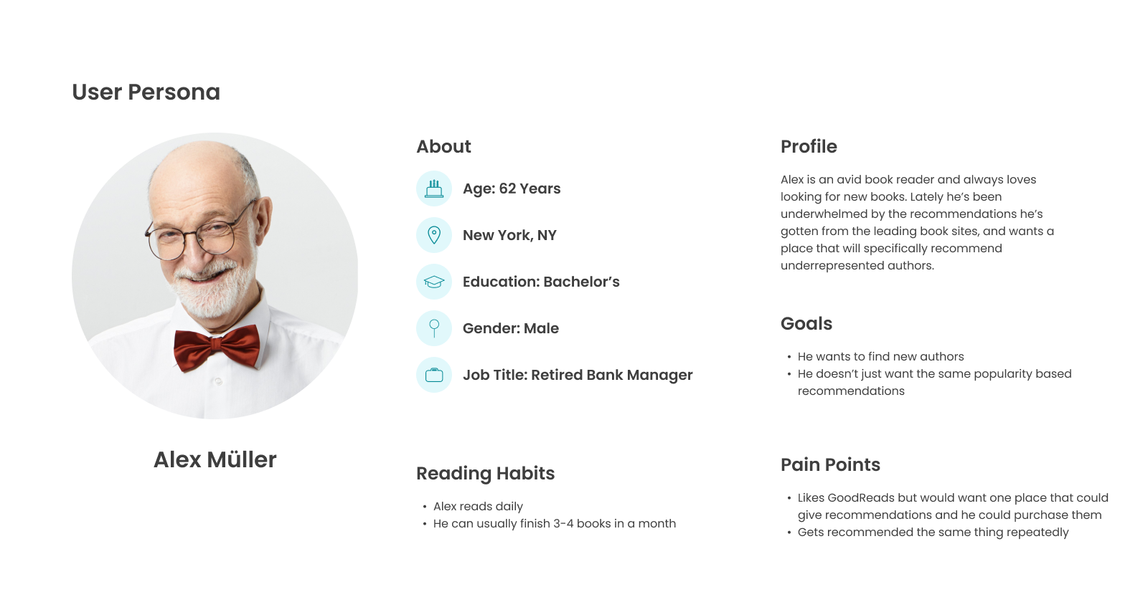

Slide 9
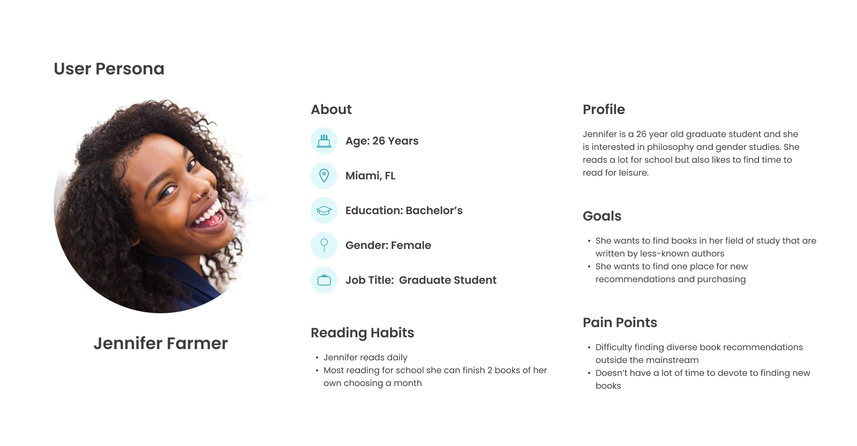

Slide 10
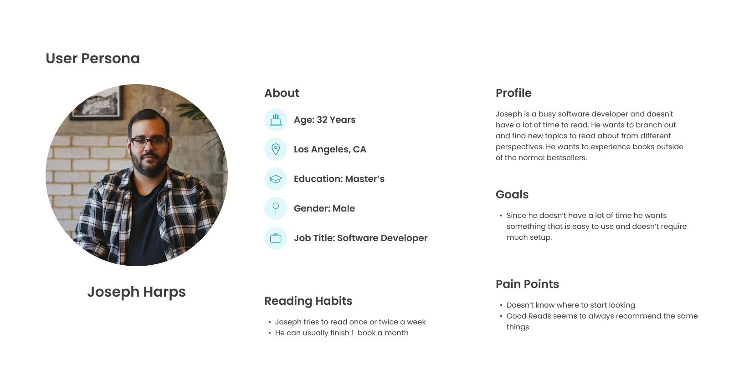

Slide 11








Technologies

Slide 12
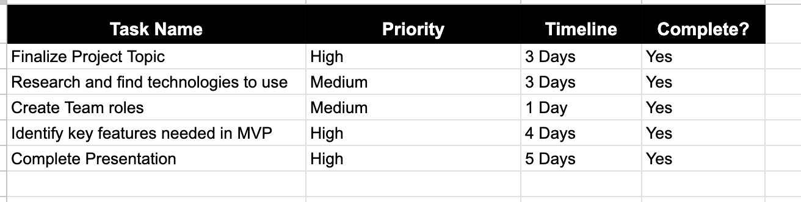
Sprint 1 Schedule

Slide 13
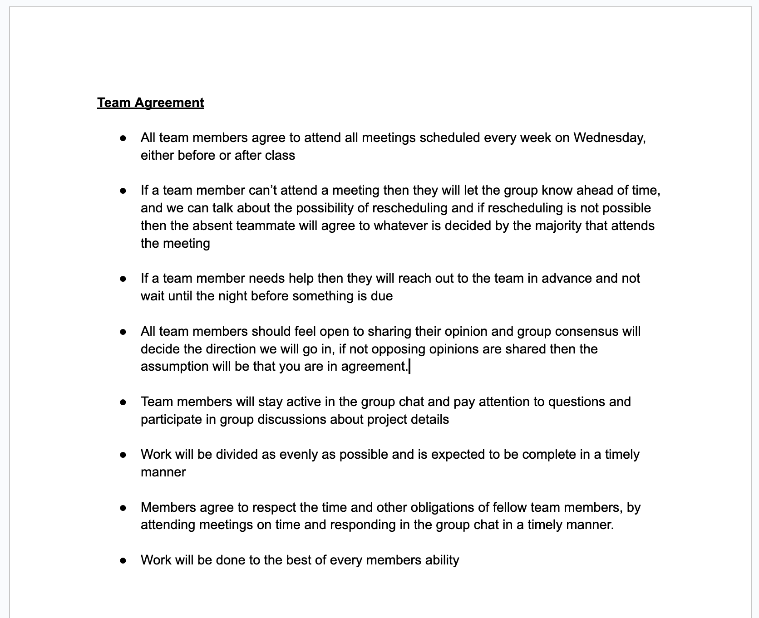
Team Working Agreement

Slide 14
Retrospective
What went well:
Team decided their roles quickly
Brainstorming for an idea was good
What can be improved:
Team communication
Time management
Action Items:
Create schedule earlier and make clearer deadlines
Weekly call for check in

Slide 15
Sprint 2 Goals
Finalize System Requirements and Design
Conduct research into different ML models and algorithms
Plan UX and UI

Slide 16
WikiPage Link
https://github.com/htmw/2024S-Code-Avengers/wiki

